Slide 1
K Nearest Neighbors

Slide 2
KNN - Definition
KNN is a simple algorithm that stores all available cases and classifies new cases based on a similarity measure

Slide 3
KNN – different names
K-Nearest Neighbors
Memory-Based Reasoning
Example-Based Reasoning
Instance-Based Learning
Case-Based Reasoning
Lazy Learning

Slide 4
KNN – Short History
Nearest Neighbors have been used in statistical estimation and pattern recognition already in the beginning of 1970’s (non-parametric techniques).
Dynamic Memory: A theory of Reminding and Learning in Computer and People (Schank, 1982).
People reason by remembering and learn by doing.
Thinking is reminding, making analogies.
Examples = Concepts???

Slide 5
K Nearest Neighbor
Lazy Learning Algorithm
Defer the decision to generalize beyond the training examples till a new query is encountered
Whenever we have a new point to classify, we find its K nearest neighbors from the training data.
The distance is calculated using one of the following measures
  Euclidean Distance
  Minkowski Distance
  Mahalanobis Distance

Slide 6
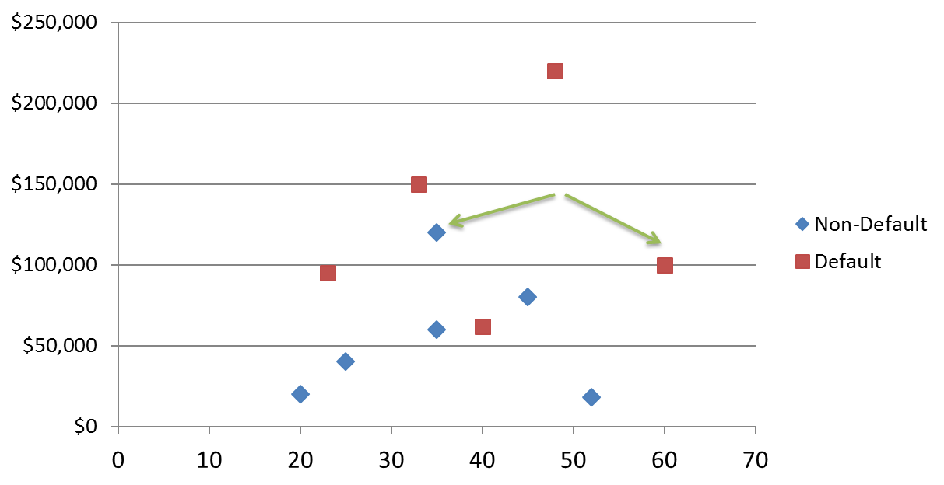

KNN Classification
Loan$
Age

Slide 7
1-Nearest Neighbor

Slide 8
3-Nearest Neighbor

Slide 9

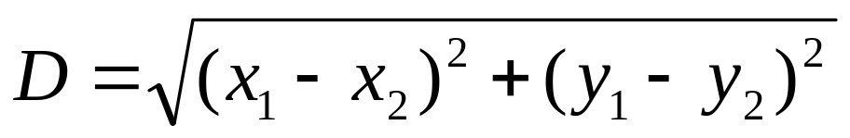
KNN Classification – Distance
Age | Loan | Default | Distance
25 | $40,000 | N | 102000
35 | $60,000 | N | 82000
45 | $80,000 | N | 62000
20 | $20,000 | N | 122000
35 | $120,000 | N | 22000
52 | $18,000 | N | 124000
23 | $95,000 | Y | 47000
40 | $62,000 | Y | 80000
60 | $100,000 | Y | 42000
48 | $220,000 | Y | 78000
33 | $150,000 | Y | 8000
48 | $142,000 | ?
Euclidean Distance
www.ismartsoft.com

Slide 10
KNN – Number of Neighbors
If K=1, select the nearest neighbor
If K>1,
  For classification select the most frequent neighbor.

Slide 11
KNN - Applications
Classification and Interpretation
  legal, medical, news, banking
Problem-solving
  planning, pronunciation
Function learning
  dynamic control
Teaching and aiding
  help desk, user training

Slide 12
Summary
KNN is conceptually simple, yet able to solve complex problems
Can work with relatively little information
Learning is simple (no learning at all!)
Memory and CPU cost
Feature selection problem
Sensitive to representation

Slide 13
Distance Measures

Slide 14
Similarity and Dissimilarity
Similarity
  Numerical measure of how alike two data objects are.
  Is higher when objects are more alike.
  Often falls in the range [0,1]
Dissimilarity
  Numerical measure of how different are two data objects
  Lower when objects are more alike
  Minimum dissimilarity is often 0
  Upper limit varies
Proximity refers to a similarity or dissimilarity

Slide 15
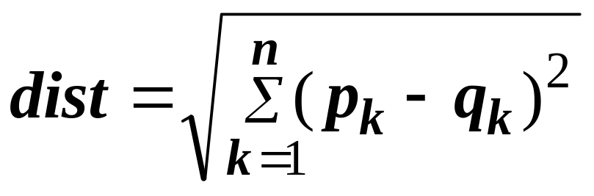
Euclidean Distance
Euclidean Distance
  Where n is the number of dimensions (attributes) and p_{k} and q_{k} are, respectively, the k^{th} attributes (components) or data objects p and q.
Standardization is necessary, if scales differ.

Slide 16
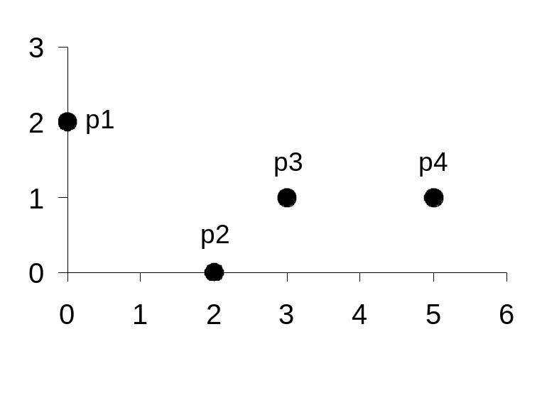
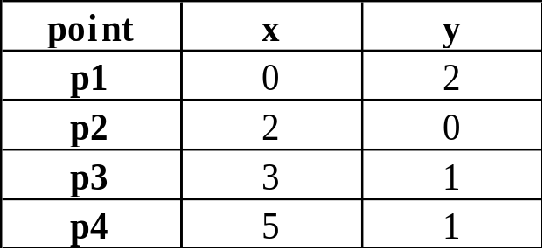
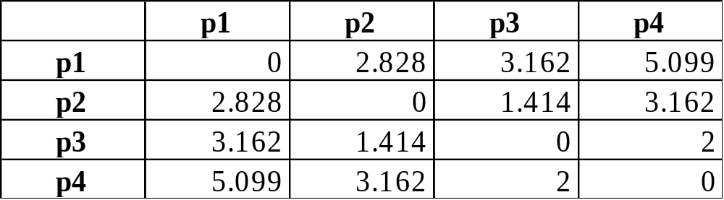
Euclidean Distance
Distance Matrix

Slide 17
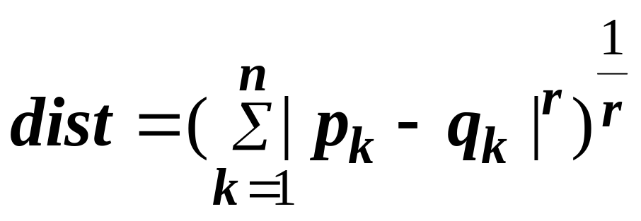
Minkowski Distance
Minkowski Distance is a generalization of Euclidean Distance
  Where r is a parameter, n is the number of dimensions (attributes) and p_{k} and q_{k} are, respectively, the kth attributes (components) or data objects p and q.

Slide 18
Minkowski Distance: Examples
r = 1. City block (Manhattan, taxicab, L₁ norm) distance.
  A common example of this is the Hamming distance, which is just the number of bits that are different between two binary vectors
r = 2. Euclidean distance
r → ∞. “supremum” (L_{max} norm, L∞ norm) distance.
  This is the maximum difference between any component of the vectors
  Example: L_infinity of (1, 0, 2) and (6, 0, 3) = ??
  Do not confuse r with n, i.e., all these distances are defined for all numbers of dimensions.

Slide 19
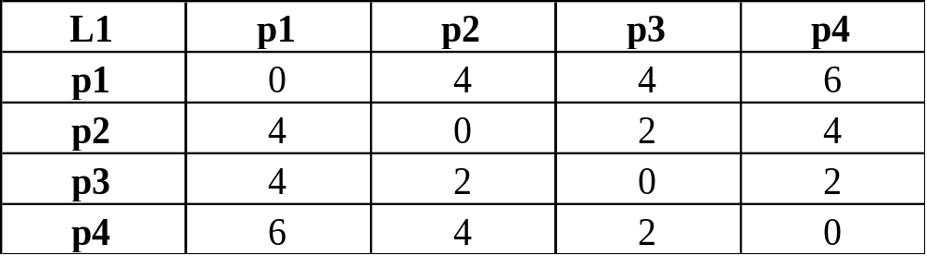
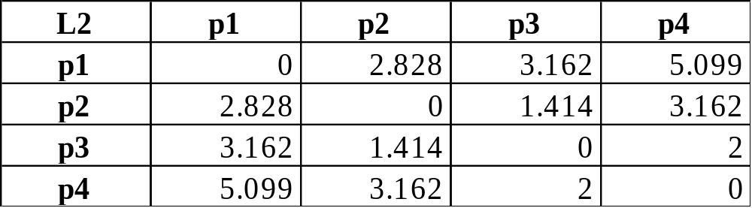
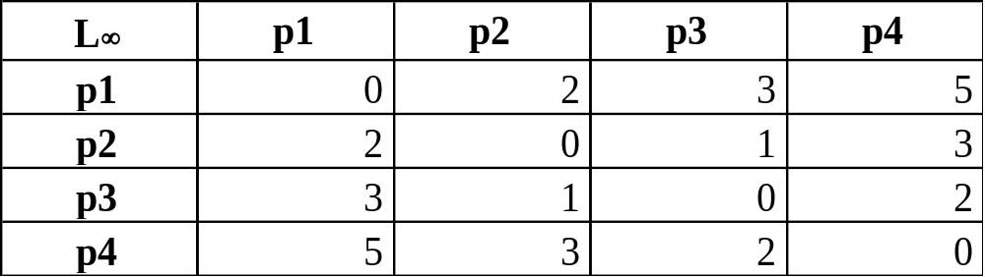
Minkowski Distance
Distance Matrix

Slide 20
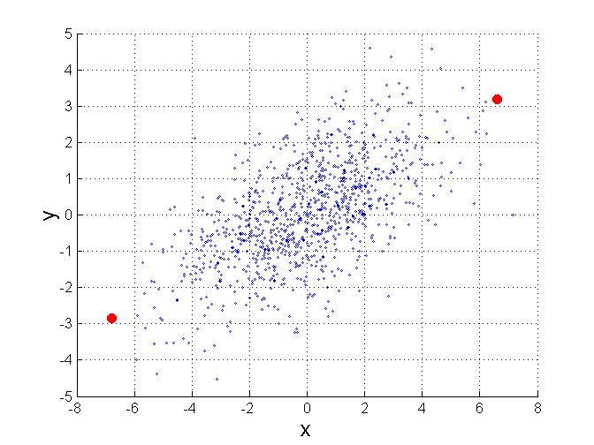
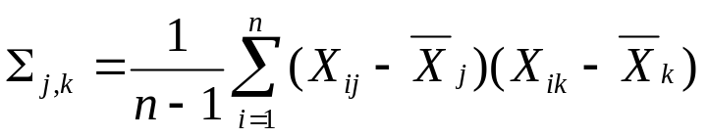
Mahalanobis Distance
Σ is the covariance matrix of the input data X
B
When the covariance matrix is identity
Matrix, the mahalanobis distance is the
same as the Euclidean distance.
Useful for detecting outliers.
Q: what is the shape of data when
covariance matrix is identity?
Q: A is closer to P or B?
A
P
For red points, the Euclidean distance is 14.7, Mahalanobis distance is 6.

Slide 21
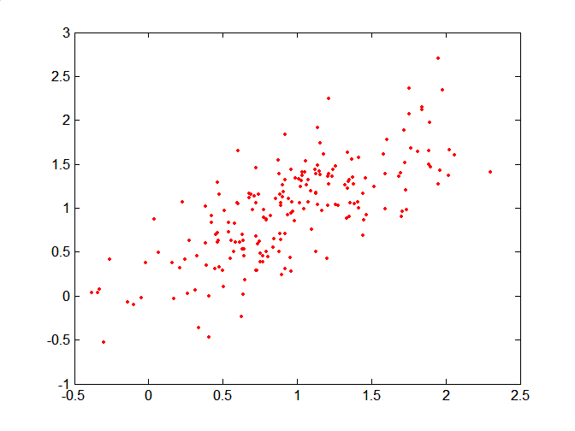
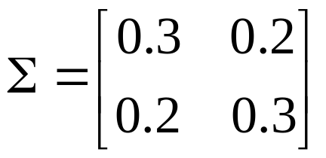
Mahalanobis Distance
Covariance Matrix:
C
B
A: (0.5, 0.5)
B: (0, 1)
C: (1.5, 1.5)
Mahal(A,B) = 5
Mahal(A,C) = 4
A

